Slide 1



Deep Learning Design Patterns with Tensorflow 2.x
Computer Vision Workshop - Hyperparameter Tuning Version: Apr 2020
Repo: github.com/GoogleCloudPlatform/keras-idiomatic-programmer
twitter.com/andrewferlitsch

Slide 2
Hyperparameters
Overview
We will cover in this section we will cover hyperparameter tuning.
Weight Initialization - the importance of numerical stability.
Warmup - “supervised” pre-training for numerical stability.
Manual Hyperparameter Search - DIY approaches.
Automatic Hyperparameter Search - with Keras Tuner.
Learning Rate Schedulers - DIY approaches and builtin.
Regularizations - conventional approaches to regularization.

Slide 3
Weight Initialization
When we first start training a model from scratch we need to give the weights some initial value. This process is called initialization.
For simplicity, we could start by setting all the weights to the same value, say 0 or 1. Yeaks, due to the manner that gradient descent works in backward propagation, each weight will have identical updates. Thus in the case, we say that the neural network is symmetrical and is equivalent to just a single node.
So, our initialize weights cannot be the same!

Slide 4
Weight Distribution
We need to set the weights in the model to some random distribution of values. Ideally, the distribution should be a small range (less than -1 and 1) and be centered at zero.
Uniform Distribution - not used anymore.
Xavier (Glorot) - Was popular when models used hyperbolic tangent as the activation function. This random distribution is a normal distribution centered at zero and with a standard deviation set to, where fan_in is the number of inputs to the layer.
sqrt( 1 / fan_in )
He-Normal - Was found to be a better distribution after switching to ReLU for activation. Same distribution as Xavier, except the standard deviation is set to:
sqrt( 2 / fan_in )

Slide 5
He-Normal Distribution
For initializing weights in Dense and Convolutional layers, one specifies the distribution with the keyword parameter: kernal_initializer
x = Conv2D(16, (3, 3), strides=1, padding='same', activation='relu', kernel_initializer='he_normal')(inputs) outputs = Dense(10, activation='softmax', kernel_initializer='he_normal')(x)

Slide 6
Lottery Hypothesis
The lottery hypothesis for weight initialization in 2019 made two presumptions:
No two draws from a random distribution are equal. In other words, some draws from the random distribution for weight initialization produce better results than others.
Large models have high accuracy because they are really a collection of small models, each having a different draw from the random distribution, and where one of the draws is the winning ticket.
While there those whom still pursue this direction: subsequent attempts to identify and extract the sub-model with the winning ticket into a compact model from a trained large model never panned out.

Slide 7
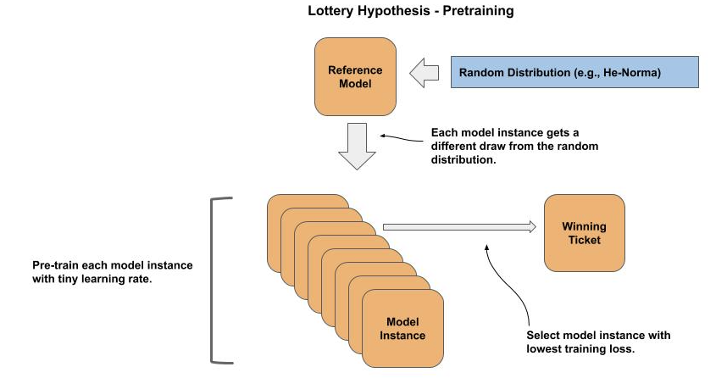
Lottery Hypothesis
Typically, when using this approach one runs a small number of epochs with a very small learning rate (e.g., 0.0001).
For each epoch, the number of steps is substantially less than the size of the training data. By doing so, one can pre-train a large number of instances in a short period of time.
Once completed, the model instance with the best objective metric, such as training loss, is selected.
The assumption is that this draw is a better winning ticket than the others.

Slide 8
Lottery Hypothesis
def make_model(): bottom = ResNet50(include_top=False, weights=None, input_shape=(32, 32, 3)) model = Sequential() model.add(bottom) model.add(Flatten()) model.add(Dense(10, activation='softmax')) model.compile(loss='sparse_categorical_crossentropy', optimizer=Adam(0.0001), metrics=['acc']) return model lottery = [] for _ in range(10): lottery.append(make_model()) from tensorflow.keras.datasets import cifar10 from tensorflow.keras.preprocessing.image import ImageDataGenerator import numpy as np (x_train, y_train), (x_test, y_test) = cifar10.load_data() x_train = (x_train / 255.0).astype(np.float32) best = (None, 99999) datagen = ImageDataGenerator()
for model in lottery: # quick pre-train of model result = model.fit( datagen.flow(x_train, y_train, batch_size=32), epochs=3, steps_per_epoch=100) print(result.history['loss'][2]) loss = result.history['loss'][2] if loss < best[1]: best = (model, loss)

Slide 9
Warmup
The numerical stability method takes a different approach from the lottery hypothesis.
In the numerical stability method a large model is viewed as divided into a higher (bottom) and lower (top) layers.
The presumption is that the lower (top) layers provide numerical stability to the higher (bottom) layers during training. That is, the lower layers provide the numeric stability for the higher layers to “learn” the winning ticket (initialization draw).
If numerical stabilized, the bottom layers are the winning ticket.

Slide 10
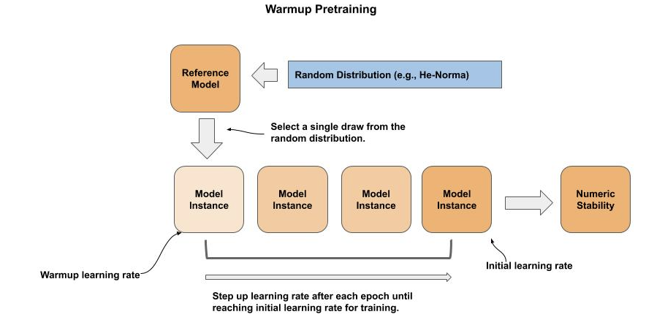
Warmup
For warmup training, we start with a very tiny learning rate to avoid causing large swings in weights and get the weights to shift towards the winning ticket. Typical initial values for the warmup learning rate are in range of 1e-4 .. 1e-5.

Slide 11
Warmup
w_lr = 0.0001 # warmup learning rate i_lr = 0.001 # initial learning rate for training w_epochs = 4 # number of epochs for warmup w_step = (i_lr - w_lr) / w_epochs # the step up in warmup learning rate after each epoch model = make_model(w_lr) def warmup_scheduler(epoch, lr): if epoch == 0: return lr return lr + w_step from tensorflow.keras.callbacks import LearningRateScheduler lrate = LearningRateScheduler(warmup_scheduler, verbose=1) result = model.fit(x_train, y_train, batch_size=32, epochs=4, validation_split=0.1, verbose=1, callbacks=[lrate])
Calculate starting warmup lr rate and lr increment size.
Warmup lr scheduler increases lr by an incremental step each epoch, until initial learning rate.
Pre-training of model for a small number of epochs w/warmup lr scheduler.

Slide 12
Hyperparameter Tuning
After weight initialization for numeric stability (whether by lottery or warmup), we do hyperparameter search (also referred to as hyperparameter tuning and hyperparameter optimization).
The goal of hyperparameter search is to find the (near) optimal hyperparameter setting to maximize training of your model for your objective (e.g., evaluation accuracy).
Typically, when training a pre-configured model the only hyperparameters we attempt to tune are:
Learning Rate
Batch Size
Learning Rate Scheduler.
Regularization

Slide 13
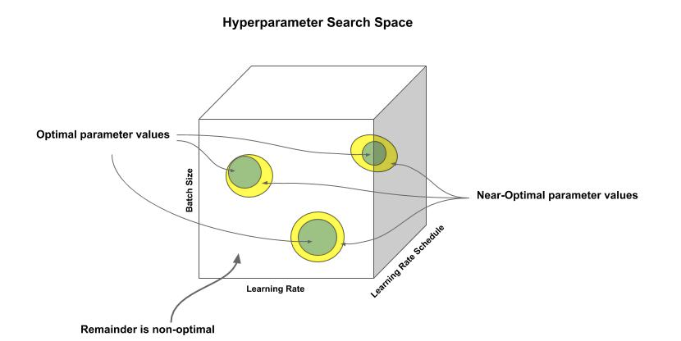
Hyperparameter Search Space
The green area represents combinations that produce optimal results. Note, there may be multiple areas such areas in the search space. Typically, within the vicinity of each optimal area is a larger area of near-optimal results, represented as yellow. The vast majority of the search space otherwise produces non-optimal/non-near results.

Slide 14
A Manual Method
I have a lot of experience training computer vision models and have a strong intuition when it comes to selecting hyperparameters. I am able to use this learned intuition to do a manually guided search. I generally follow these initial four steps:
Coarse tune the initial learning rate.
Tune the batch rate.
Fine-tune the initial learning rate.
Tune the learning rate scheduler.

Slide 15
Coarse Tune Initial Learning Rate
Example of my manual method:
Use a constant batch size:
32 if small dataset, 256 if large dataset.
Pick a range of three learning rates, each a magnitude lessor than the last:
0.01, 0.001, 0.0001
Run an initial training with a few epochs for each of the three learning rate, and pick the one with best validation loss.
Pick the halfway value between the best and previous (e.g., 0.005) and do a final run to see if the halfway point is better.
If new pick is better, repeat the process with the next halfway value (divide and conquer).
There is a high likelihood I am in a near-optimal area (yellow).

Slide 16
Tune the Batch Size
Example method:
I increase the batch size by:
Continuously by a factor of 2.
Run a few epochs and see if it improves.
If not select, the previous “best” batch size.
At this point, there is a high likelihood that I have gotten closer to a optimal area (green).

Slide 17
Fine Tune the Learning Rate
The larger the batch size, the less variance we will have on the loss per batch. As a result, we typically can raise the learning rate if we had increased the batch size.
Example:
Repeat the tuning experiments for the learning rate;
Use the coarse learning rate as the center point.
Example: if 0.001, then rates to try at [ 0.01, 0.001, 0.0001]

Slide 18
Tune the Learning Rate Scheduler
I will start a full training run with early stopping when the validation accuracy stops improving.
I generally first try cosine annealing on the learning rate (discussed subsequently). If that makes a significant improvement, I generally stop there.
Otherwise, I look back at the initial full run and find the epoch where validation accuracy plateaued or diverged. I then set a learning rate scheduler to drop the learning rate by one magnitude one epoch before that point.
This generally gives me a really good starting point, and I can now focus on other pre-training steps like augmentation and label smoothing (discussed subsequently).

Slide 19
Grid Search
Grid search is the oldest form of hyperparameter search. It means that you search every possible combination. This is only practical with a few parameters and values.
best = (None, 0, 0, 0) epochs = 5 for lr in [0.1, 0.01]: for bs in [32, 64]: model = get_model(lr) result = model.fit(x_train, y_train, batch_size=bs, epochs=epochs, validation_split=0.1) val_acc = result.history['val_acc'][epochs-1] if val_acc > best[1]: best = (model, val_acc, lr, bs)
Combinations for
learning rate and
batch size.
Run for a few epochs.
Remember which combo has the best validation loss.

Slide 20
Random Search
So you might ask, how could a random search be computationally less expensive than a grid search -- it’s just random?
We know that only a small portion of the hyperparameter space has an optimal combination, and thus we would have a very low probability of finding one randomly.
But we also know there are substantially larger areas that are near-optimal, and we have a substantially higher probability of landing in one using a random search.
Once the search finds a near-optimal combination, we know there is a good likelihood that there is an optimal combination in the vicinity.

Slide 21
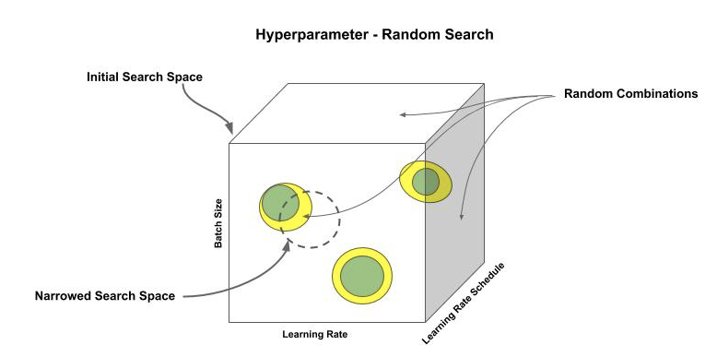
Random Search
To summarize the steps:
You set the boundaries for the search space.
Do random search within the entire search space.
Once a near-optimal combination is found, narrow the search space to the vicinity of the new combination.
Continuously repeat until a combination meets your objective criteria.
If a new combination improves the result, further narrow the search space around the new combination.
If after some predefined number of tries does not improve, return back to searching the entire search space (step 2).

Slide 22
Keras Tuner
The KerasTuner is an add-on module to TF.Keras for doing automated hyperparameter tuning. It has two methods: random search, and hyperband search.
Like all automated tools, KerasTuner has pros and cons. Being automated and fairly straightforward to use is obviously good. For me, the lack of the ability to tune the batch size is a big con, which you have to tune manually.
Below is the pip method for installing KerasTuner.
pip install -U keras-tuner

Slide 23
Keras Tuner - Random Search
To use KerasTuner we start by creating an instance of the tuner. In the example below we instantiate an instance of the RandomSearch class. This instantiation takes three required parameters:
Hyperparameter tunable (hp) model.
The objective measurement (e.g., validation accuracy).
The maximum number of training trials (experiments).
from kerastuner.tuners import RandomSearch # Instantiate a tuner for random search tuner = RandomSearch(hp_model, objective='val_acc', max_trials=3)

Slide 24
Keras Tuner - hp model
The hp_model is a function which will provide instances of our model with different hyperparameter settings.
The parameter hp is passed in by the tuner and has the random selections for the trial.
When building or compiling one uses the hp methods to specify what parts of the model are tunable and corresponding choices or range.
def hp_model(hp): ''' hp is passed in by the tuner ''' model = tf.keras.models.load_model('numeric') model.compile(loss='sparse_categorical_crossentropy', metrics=['acc'], optimizer=Adam(hp.Choice('learning_rate', values=[1e-1, 1e-2, 1e-3, 1e-4]))) return model
Tune the learning rate for the four possible choices.

Slide 25
Keras Tuner - Trials and Result
We invoke the trials with the tuner search() method, whose parameters are the same as the fit() method.
tuner.search(x_train, y_train, batch_size=32, validation_data=(x_test, y_test))
You then use the get_best_models() method to get the corresponding model. This method returns a list of models based on the parameter num_models. In our case we just want the best one so we set it to 1.
models = tuner.get_best_models(num_models=2) model = models[0]
Finally, your results and models are stored in a folder, which can be specified by the parameter project_name when instantiating the tuner. When not specified, the folder name defaults to untitled_project. To clean up after your trials, you would delete this folder.

Slide 26
Learning Rate Scheduler
While we can get good results with a constant learning rate, it is not as effective as adjusting the learning rate during training.
Typically, we progress from a larger learning rate to a lower learning rate during training.
Start with a large learning rate:
Not too large to cause numerical instability - found by hyperparameter tuning.
Explore more paths for local optimas to converge on - increase likelihood of find best (or good) optima.
Make some initial large gains towards convergence - speed up training.
But once we are making good progress down a good local optima, if we keep using the high learning rate we may start oscillating back and forth without converging or inadvertently jump out of the good local optima and start converging in a less good local optima.
As we get closer to convergence, we start to lower the learning rate to make smaller and smaller steps, so as to not oscillate and find the best path in the local optima to converge on.

Slide 27
TF.Keras Decay
The TF.Keras optimizers support progressively lowering the learning rate with the decay parameter.
In TF.Keras the time decay is implemented as, iterations is the number of epochs executed so far.
lr = lr * (1.0 / (1.0 + decay * iterations))
Below is an example of setting a time decay for the learning rate when specifying the optimizer in the compile() method.
model.compile(optimizer=Adam(lr=0.1, decay=1e-3))
Typical decay values are between 1e-3 and 1e-6.

Slide 28
TF.Keras Decay
The table below shows the progression in learning rate for 10 epochs with lr=0.1 and decay=1e-3.
Iteration (epoch) | Learning rate
1 | 0.0999
2 | 0.0997
3 | 0.0994
4 | 0.0990
5 | 0.0985
6 | 0.0979
7 | 0.0972
8 | 0.0964
9 | 0.0955
10 | 0.0945

Slide 29
Learning Rate Scheduler
One can implement a custom method for progressively lowering the learning rate using the LearningRateScheduler callback.
from tensorflow.keras.callbacks import LearningRateScheduler def lr_scheduler(epoch, lr): ''' Set the learning rate at the beginning of epoch epoch: The epoch count (first epoch is zero) lr: The current learning rate ''' if epoch == 0: return lr # set new learning rate return n_lr model.compile(loss='categorical_crossentropy', optimizer=Adam(lr=0.01)) lr_callback = LearningRateScheduler(lr_scheduler) model.fit(x_train, y_train, epochs=epochs, batch_size=batch_size, callbacks=[lr_callback])
Calculate a new learning rate for this epoch.
Create the scheduler as a callback during training.

Slide 30
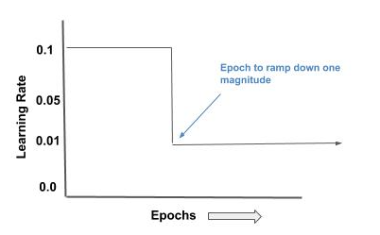
Ramp Method
This is (was) a common strategy. During an initial trial full-training (after tuning) the validation loss/accuracy are observed after each epoch. At some epoch, one would generally observe a plateau or even a divergence.
Let’s say that occurs at epoch 38. We set a ramp to dropdown (typically a magnitude) the learning rate a few epochs earlier, say 35 and restart the training.
This method typically produces a better accuracy than a constant learning rate.
epoch_ramp = 35 def lr_scheduler(epoch, lr): if epoch == epoch_ramp: return lr / 10.0 return lr

Slide 31
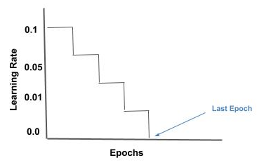
Constant Step Method
In the constant step method, one wants to go from the initial learning rate to zero on the last epoch in even increments. The method is straightforward. You take the initial learning rate and divide it by the number of epochs.
epochs = 200 lr = 0.001 step = lr / epochs def lr_scheduler(epochs, lr): ''' step learning rate ''' if epoch == 0: return lr return lr - step

Slide 32
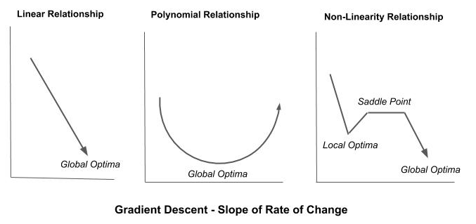
Cosine Annealing
The cosine annealing method has been popular among researchers and appears frequently in research papers when doing ablation studies. It is also known as a cyclic learning rate.
The concept here is instead of progressively lowering the learning rate across the training, is to do it in cycles.
Advantages:
Periodically explore other local optima (jump out) -- it’s like doing a beam search.
Escape saddle points.

Slide 33
Cosine Annealing
Below is an example implementation of a learning rate scheduler using cosine decay:
e_steps : the number of steps (batches) in an epoch
t_steps : the total number of steps (batches) for all epochs.
alpha : the minimum learning rate value (lower bound)
def cosine_decay(epoch, lr, alpha=0.0): """ Cosine Decay """ cosine_decay = 0.5 * (1 + np.cos(np.pi * (e_steps * epoch) / t_steps)) decayed = (1 - alpha) * cosine_decay + alpha return lr * decayed def lr_scheduler(epochs, lr): ''' cosine annealing learning rate ''' return cosine_decay(epochs, lr)

Slide 34
TF 2.x builtin Cosine Annealing
Below is an example implementation of a learning rate scheduler using cosine decay:
from tf.keras.experimental import CosineDecay lrate = CosineDecay(initial_learning_rate, decay_steps, alpha) model.fit(x_train, y_train, epochs=epochs, batch_size=batch_size, callbacks=[lrate])
Create the callback.
Add to training.

Slide 35
Weight Regularization
The most widely used form of regularization currently is weight regularization, which is also referred to as weight decay.
Weight regularization is applied on a per layer basis.
It adds some noise to the update of the weights during backward propagation that is relative to the size of the weights.
This noise is commonly referred to as a penalty, and layers with larger weights have a larger penalty than layers with smaller weights.

Slide 36
Weight Regularization
In the ablation studies of modern SOTA research papers we see using L2 weight regularization around the value ranges of 0.0005 to 0.001. From my own experience, I found values above 0.001 to be too aggressive in weight regularization and the training does not converge.
The keyword parameter kernel_regularizer is used to set weight regularization on a per layer basis. If you use it, you should specify it on all layers that have learned parameters (e.g., Conv2D, Dense).
from tensorflow.keras.regularizers import L2 inputs = Input((128, 128, 3)) x = Conv2D(16, (3, 3), strides=(1, 1), kernel_regularizer=L2(0.001))(inputs)

Slide 37
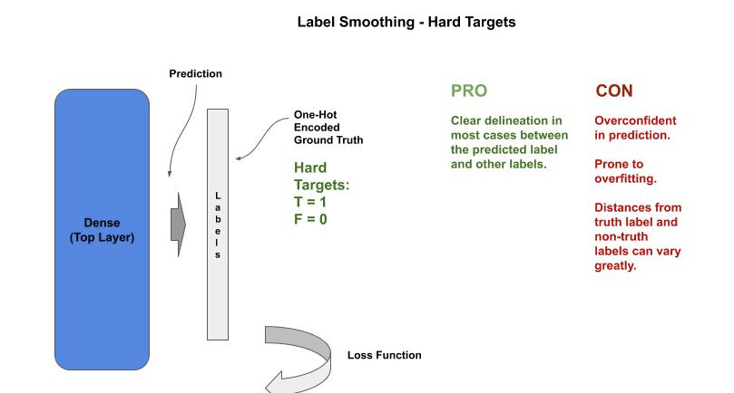
Label Smoothing
Label smoothing approaches regularization from a different direction.
What we find that when we penalize these weight updates to prevent memorization, these models tend to be overconfident in their prediction (high probability value).

Slide 38
Label Smoothing
Label smoothing aids in generalizing the model by making the predictions less confident, which results in the distances between ground truths and non-ground truths to cluster together.
We alter the one-hot encoding labels (ground truths) from being absolute certainty (1 and 0) to something less than absolute certainty, denoted as α (alpha).
For example, for the ground truth label instead of setting the value to 1 (100%):
Set it to something slightly less like 0.9 (90%),
Change all the non-truths from 0 (0%) to the same amount we lowered the ground truth label (e.g., 10%).

Slide 39
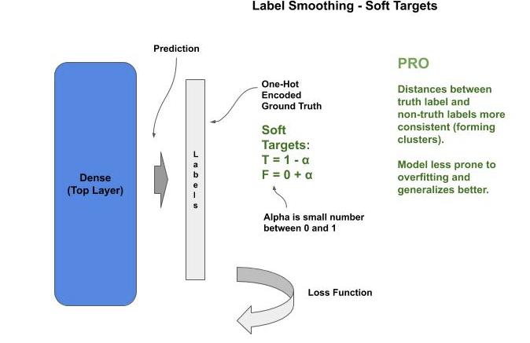
Label Smoothing
from tensorflow.keras.losses import CategoricalCrossentropy model.compile(loss=CategoricalCrossentropy(label_smoothing=0.1), optimizer='adam', metrics=['acc'])

Slide 40
THANK YOU FOR WATCHING
Google Cloud AI Developer Relations AI Training

Slide 41
Hyperparameter Tuning - Lab Exercise #XX
Optional Code Lab - Get Familiar with Hyperparameter Tuning
Deep Learning Design Patterns - Workshop - Chapter 6.ipynb

